Slide 1
Private Equity Investment in Childcare Markets
Aisling Gallagher
Massey University,
New Zealand

Slide 2
What’s particular about private equity investment?
The way in which childcare is viewed as a financial asset
Based on debt and expansion while conditions are favourable
Short financial horizon
Purchased companies often used to leverage further finance
Less visibility and transparency in terms of government oversight

Slide 3
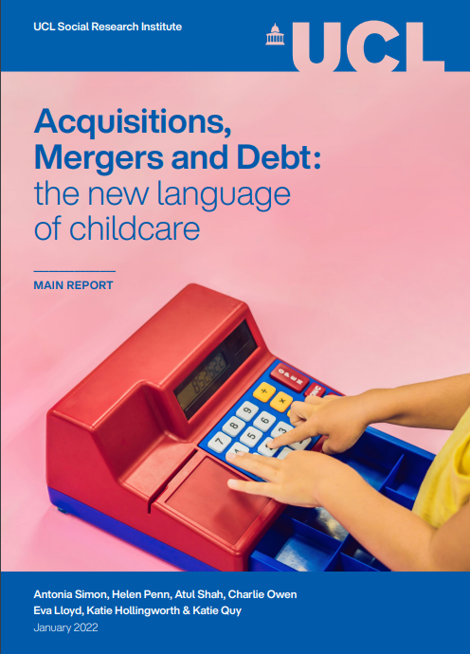

Slide 4
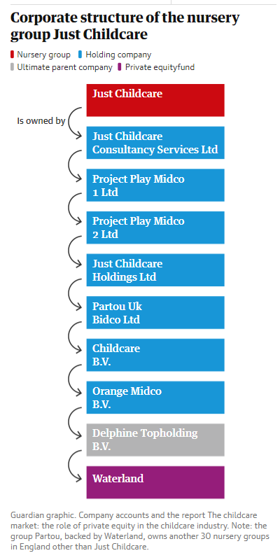
Figure 1
Figure 2

Slide 5
Cited work
Aguilar Garcia, C. et al (March 2024),The Bumper Profits taken by English Private Nurseries, The Guardian Online
Davies, R (August 2023), Golden Goose: Why Private Equity is eyeing up UK essential services, The Guardian Online
Big Steps/United Workers Union (2021), Spitting off Cash: Where does all the money go in Australia's early learning sector?
Simon, A, et al (2022), Acquisitions, Mergers and Debt: The New Language of Childcare, UCL Social Research Unit

