Slide 1
Lake St. Martin
Early Learning and
Childcare Family Centre

Slide 2
History
The community of Lake St. Martin was flooded in 2011 and was relocated to various places in Manitoba but predominantly many people lived in Winnipeg.
The flood was a way for the province of Manitoba to save the city of Winnipeg.
The people were kept from a community until the governments and First Nation leadership could decide on what is now the new Lake St. Martin community.
The impacts of this event are ongoing and will most likely be felt for a long time.

Slide 3
Rebuilding/Relocation
There are approximately 5,000 membership to the Lake St. Martin First Nation.
There are about 300 homes in the community and infrastructure buildings, ex. The school, water treatment plant, band administration, child welfare building, and the child care centre.
This rebuilding is ongoing and will most likely continue for some time.

Slide 4
Background
Lake St. Martin (LSM) First Nation had its first ‘daycare’ in 2006.
At that time being as an ECE 111, I was hired to design, recruit, find training for the people who would work in the centre

Slide 5
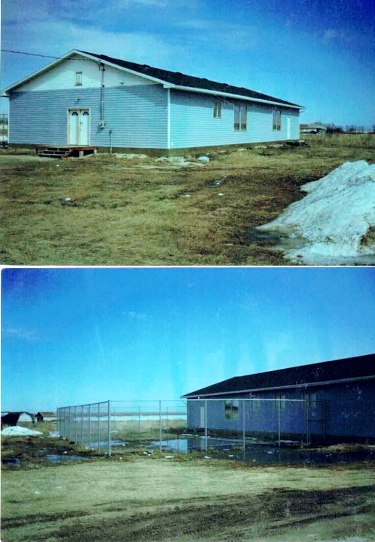

Slide 6
Grand Opening for our new centre
Our new daycare officially opened on September 25, 2023
We invited Lake St. Martin Elders
The Assembly of Manitoba Chiefs Representatives
Manitoba First Nation Education Resource Centre
Assiniboine College Representatives

Slide 7
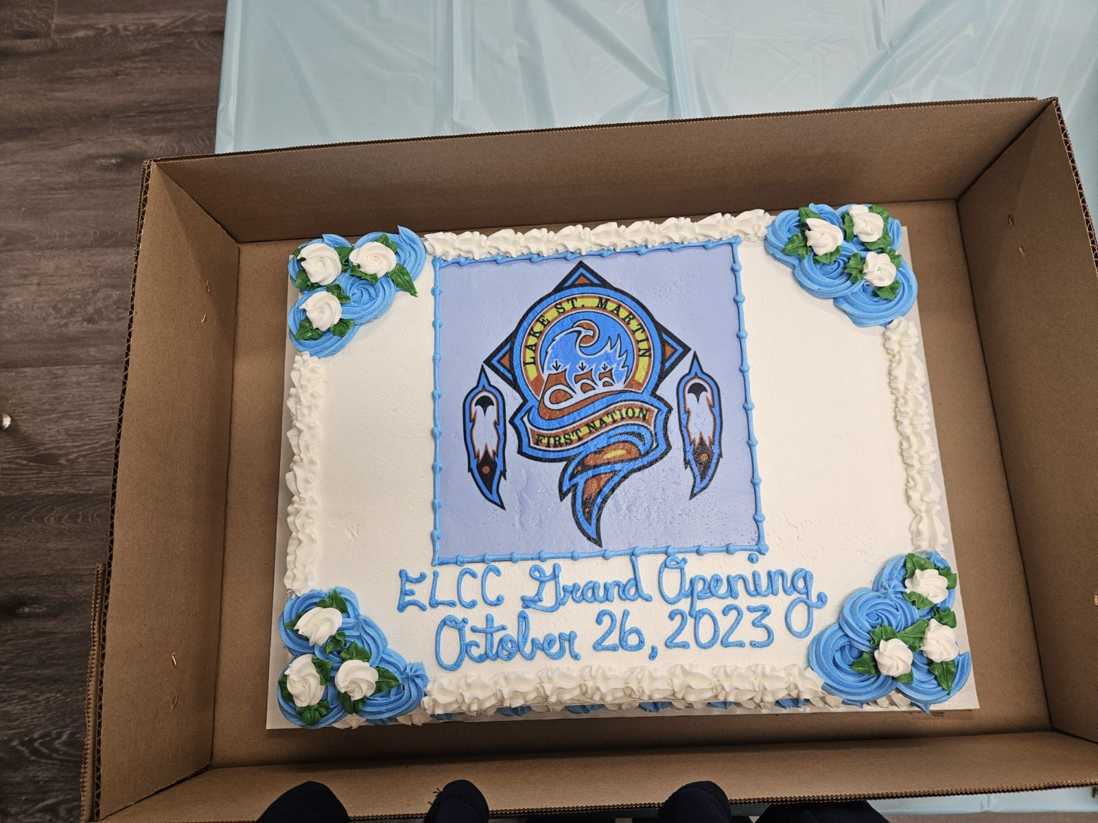

Slide 8
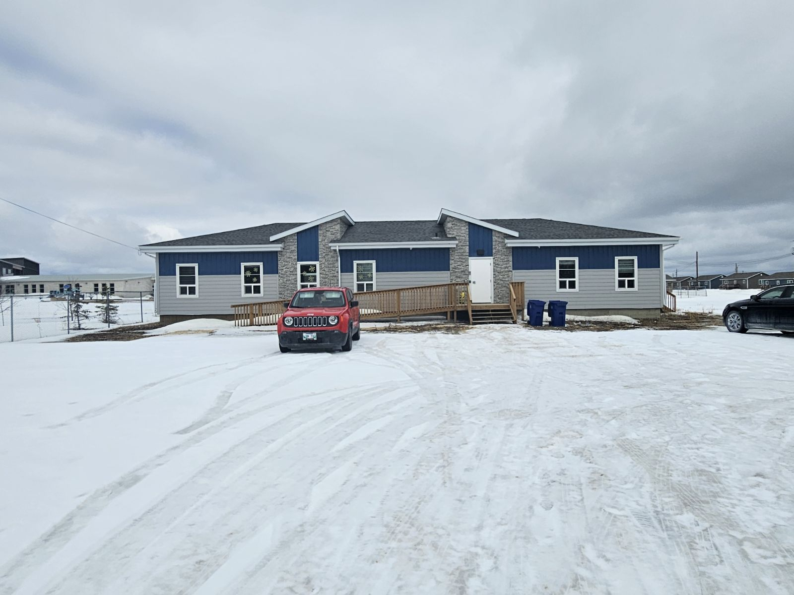

Slide 9
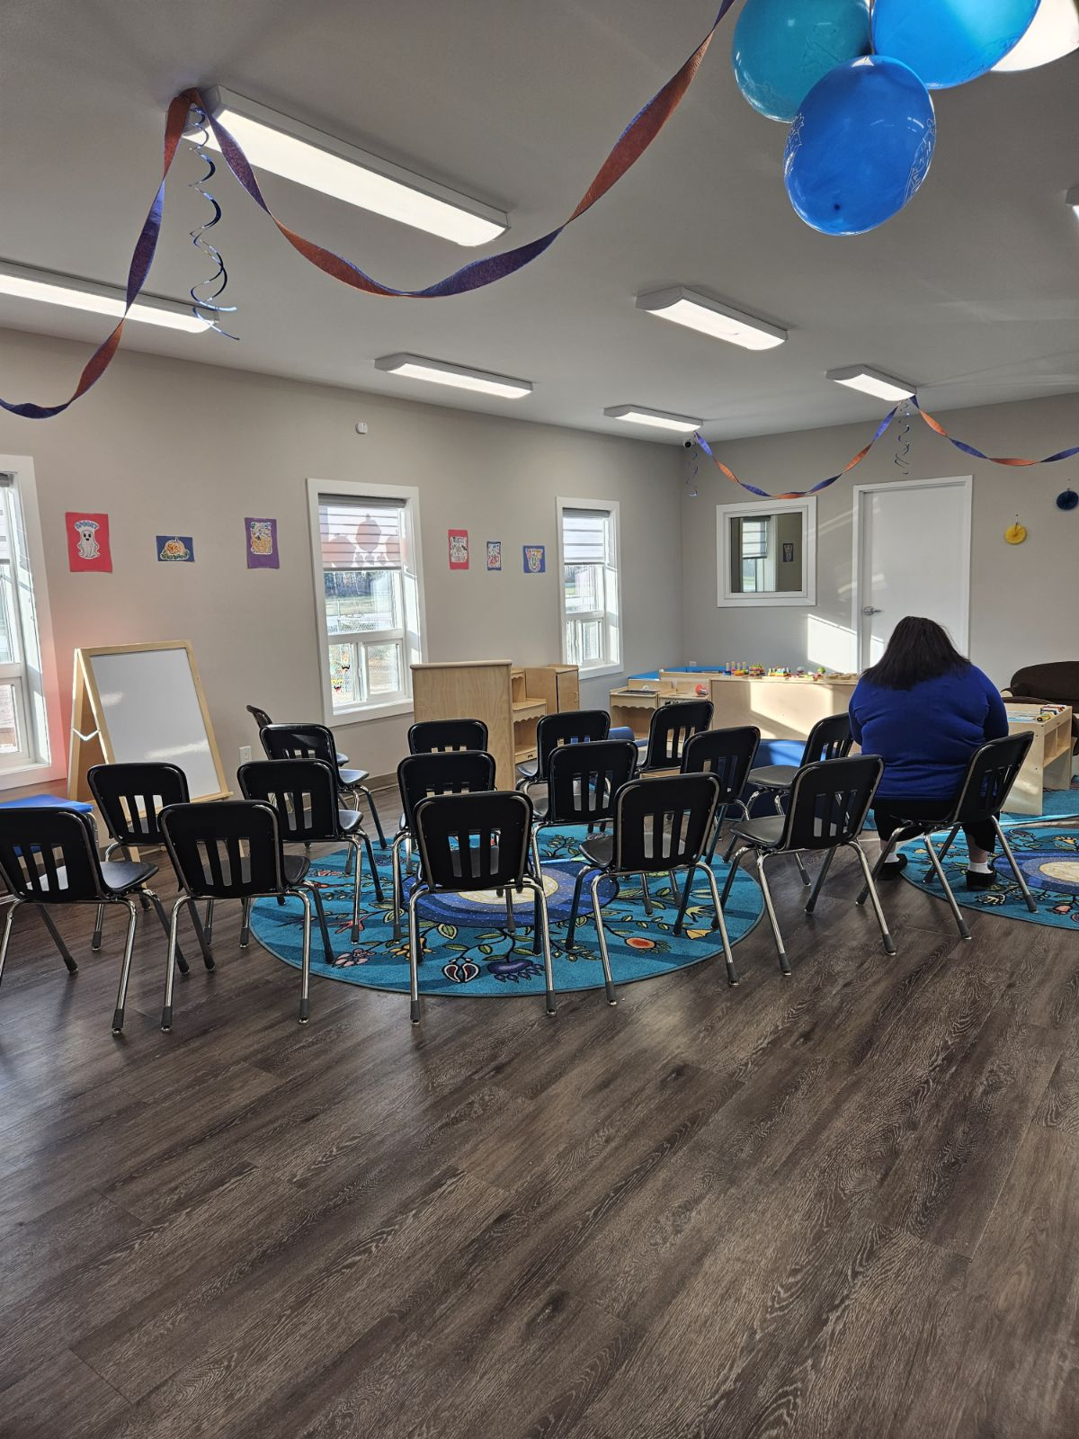

Slide 10
Present Day Update
We have been assessed to have 22 spaces in our facility.
Includes 4 infant/toddler spaces and 18 pre-school
We have 6 staff members, 2 of which have their Child Care Assistant Training

Slide 11
Ownership
The childcare centre is located in the center of the Lake St. Martin First Nation Community
This new location was identified by federal and provincial governments in collaboration with Lake St. Martin leadership

Slide 12
Monitoring and Licensing
Presently the centre is not provincially licensed, however
MFNERC has given us support and information in what we need to meet the needs for the health and safety of the children in our centre.
Chief and Council oversee our funding and support in management whatever the centre requires to operate in a daily basis.
The provincial health and safety inspector comes to our centre on a quarterly basis (4 times a year).

Slide 13
Training
As the director of this centre I have my ECEIII and my Bachelor of Arts Degree from the University of Manitoba with a Major in Native Studies.
In collaboration with Assiniboine Community College, Lake St. Martin was able to deliver the Childcare Assistant Course in March of 2023.
15 Students were enrolled in the program, and we employ 2 of the graduates.
We are still in collaboration with Assiniboine Community College to train up to 20 students for their ECEII diplomas in the next 3 years.

Slide 14
Children and Families
Many of the families who utilize our services work in the community in education, health, child welfare or the infrastructure of the ongoing development of our community.
The children range in ages from 12 months to five years old.
The single parent family are men or women.
We are a fast-growing community and therefore are looking forward to the expansion of our centre.

Slide 15
Future
As with most First Nations, Lake St. Martin is a resilient community.
People have closeknit relationships with their families, each other, and strive to have the best for their children.
The present day centre is a welcoming positive environment for the children, their parents and other community members.
Present day leadership recognize the need for ongoing training, health and safety assessments as we continue to grow.

