Slide 1
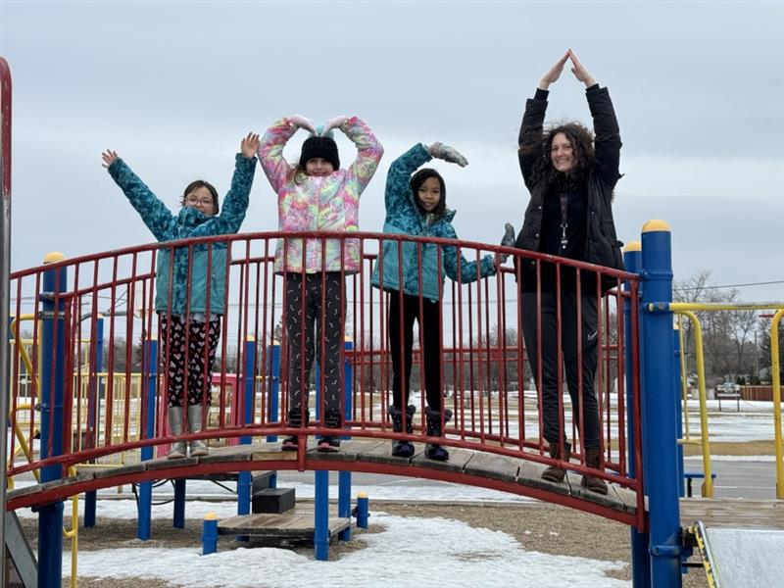
YMCA-YWCA of Winnipeg
Caryn LaFlèche – Vice President, Child Care and Development
Symposium • April 4, 2024
Non-profit child care panel

Slide 2
Agenda
More than a gym and a pool!
Governance Structure
Administrative Support
Curriculum
Staff Development

Slide 3
More than a gym and pool!
The Y is also the largest not-for-profit child care provider in Manitoba, (and in Canada).
We have 38 child care programs, with almost 400 educators and 2000 children in Winnipeg and surrounding area. (Bird’s Hill, West St. Paul and St. Andrews)
5 preschool centres with infants in 3 of those centres.
16 school age programs with kindergarten child care.
17 school age only programs.

Slide 4
Governance structure YMCA-YWCA of Winnipeg governance structure is not like stand alone child care centres. The Board of Directors governs the entire organization. They are chosen and voted in for their broad range of expertise. Every centre has Parent Advisory Council that meets twice a year to discuss the program, family involvement, activities that interest them as well as a general overview of what is going on in the centre and at the Y. The President-CEO, VP of Child Care & Development, Manager and Directors oversee the childcare facilities within the Y to varying degrees.

Slide 5
Administrative Support
The Y has a Human Resource Department that supports hiring, performance management, payroll, and benefits.
A registration team helps enroll children, as well as take payments, so directors in centres do not have to.
The Finance Department accepts payments from child care grants and manages the accounting.
And an IT department supports all things IT.
As we have almost 400 Educators, we are able to internally mentor, and provide opportunities for educators to grow and move up within the Ys Child Care community and outside. We support each other in larger capacities as well.

Slide 6
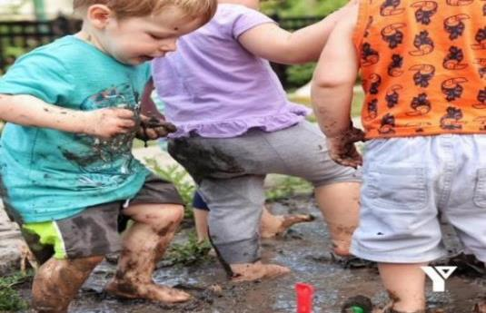
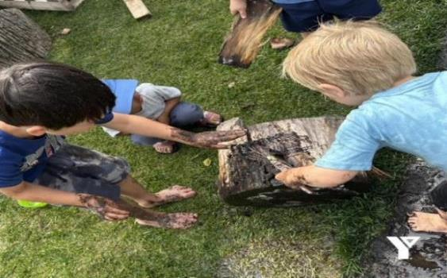
Curriculum
There are multiple opportunities from within the YMCA-YWCA of Winnipeg as well as being part of YMCA Canada for program and curriculum development.
Building Blocks on Balmoral, one of our infant and preschool programs is a Y Canada Learning and Teaching Hub for Outdoor Play. They are participants in a research project with the Lawson Foundation, South-Western Ontario YMCA, and multiple colleges across Canada on the benefits of outdoor play. The educators at this site participate in specialized Outdoor Play training, where educators do 12 modules on theory, implementing, planning and the benefits of outdoor play.

Slide 7
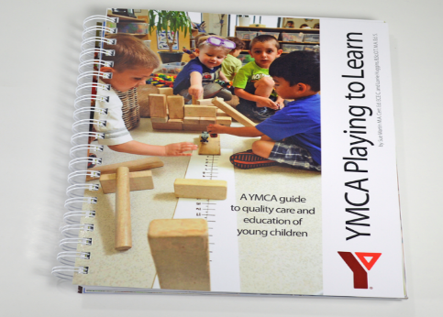
Curriculum (cont)
As a part of Y Canada, we have a specific curriculum which we follow, called YMCA Playing to Learn™ for Infant and Preschool. Our educators are required to take five 8-hour training sessions on our curriculum to understand and to properly execute it. It is an emergent, play based curriculum that aligns with child care in Manitoba. Our child care director team has “Curriculum Champions” who are able to teach the curriculum as well as ensure it is being followed and supported in each centre. We also follow the YMCA A Place to Connect™ curriculum, which is designed for children 5-12 years-old who attend our School Age programs. The curriculum is built on many of the principles that guide our Playing to Learn™ curriculum.

Slide 8
Staff Development
We are fortunate to have numerous directors and supervisors who are trained as trainers in Circle of Security, NVCI, as well as a director who is a Forest School Practitioner. Due to our unique structure, we are able to provide training in house.
With a large collection of centres, educators have the opportunity to work at a variety of centres and gain experience in different programs, age groups and environments.
Our team is also encouraged to take other workshops that are meaningful to them. We pay for our educators to be members of MCCA, as we know that being part of our Professional Association and continuing professional development is extremely important.
The Y closes all centres early once a month to ensure we can have staff meetings, as well as close for the allowable 2 days a year per provincial directives. We organise these 2 days in a conference style, which provides great networking for the team.

Slide 9
Thank you! Caryn LaFlèche Vice President, Child Care and Development YMCA-YWCA of Winnipeg caryn.lafleche@ymanitoba.ca

