Slide 1
Childcare in Québec Featuring Dr. Sophie Mathieu
Dr. Sophie Mathieu
Co-Investigator, Reimagining Care/Work Policies
Senior Program Specialist, Vanier Institute of the Family

Slide 2
This PowerPoint slide deck was created by team members working on the Reimagining Care/Work Policies (RC/W) project, funded by a SSHRC Partnership Grant (PI Andrea Doucet), to support teaching and learning of Canadian family policy.
Please cite as:
Thompson, K., Mathieu, S., McKay, L., Thompson, K., Sasso, M. (2022) Childcare in Québec, Featuring Dr. Sophie Mathieu [PowerPoint presentation]. Reimagining Care/Work Policies. https://rcwproject.ca/.
Illustrations by Diana Tzinis. © 2022 Reimagining Care/Work Policies
Instructors are invited to use this PowerPoint slide deck, and other learning resources, in accordance with their lesson plans and objectives, using the following two copyrights. Illustrations must not be altered in any way, and must be credited to Diana Tzinis, © 2022 Reimagining Care/Work Policies. The rest of the PowerPoint slide deck (and learning resources) may be adopted or adapted under the following license:
Creative Commons Attribution-NonCommercial-ShareAlike 4.0 License

Slide 3
Background
In 1997, the Québec Educational Childcare Act was signed, establishing affordable childcare across the province
In 2021, the federal government announced its Canada-wide Early Learning and Child Care Plan and an Indigenous Early Learning and Child Care Framework, citing Québec as the model to follow
The goal is an average cost of $10 per day for all regulated childcare spaces in Canada by 2026, and annual growth in new spaces

Slide 4
Translations of words used in the Video
Centres de la petite enfance (CPE): Pre-school Early Childhood Centres
Garderie: Daycare (including before-and-after school)
Illustration by Diana Tzinis
© 2022 RC/W

Slide 5
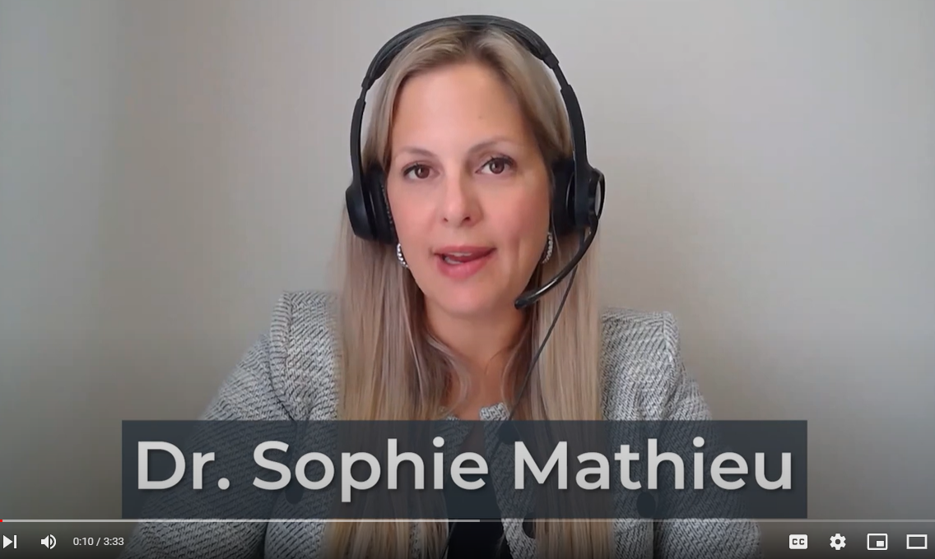
Video: Childcare in Québec, Featuring Dr. Sophie Mathieu
https://youtu.be/ZKZBQa4HjEE

Slide 6
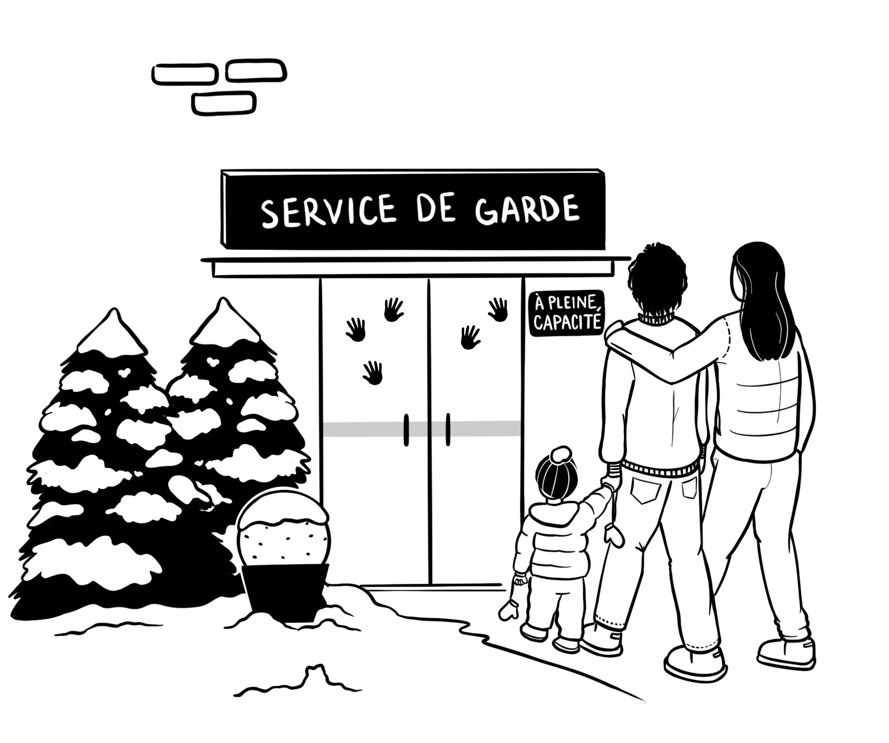
Lessons from the Québec Model
Nonprofit childcare centers offer the highest quality of care
In Québec, the supply of childcare has never been able to meet the demand. If affordable childcare is offered, people will want it.
Illustration by Diana Tzinis © 2022 RC/W

Slide 7
Childcare has three dimensions
Affordability
Quality
Accessibility

Slide 8
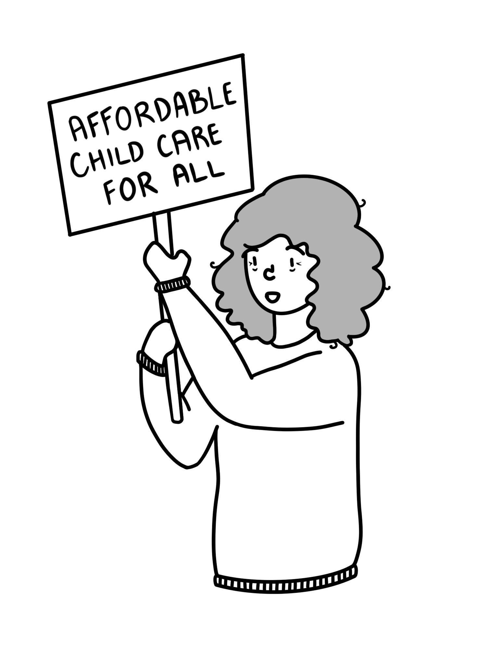
Affordability
Québec’s early childcare program is highly affordable
In 2022, parents with children enrolled in a CPE or subsidized garderie pay only $8.50 per day for 10 hours of care, two snacks and a lunch
Parents who use more expensive unsubsidized childcare are entitled to a refundable tax credit to cover part of their childcare costs
Illustration by Diana Tzinis © 2022 RC/W

Slide 9
Childcare cost in four Québec cities, compared to 32 other Canadian cities
Source: CCPA (2021) "Sounding the Alarm: Covid-19’s impact on Canada’s precarious child care sector”

Slide 10
Quality
Across the three types of childcare centres, the quality varies:
Highest: Subsidized, non-profit centres, called centres de la petite enfance (CPE)
Lower: Subsidized, for-profit garderies
Lowest: Unsubsidized, for-profit garderies

Slide 11
Accessibility
Parents across Québec continue to struggle to access a high-quality childcare space
The supply of childcare spaces has never been able to meet demand
Illustration by Diana Tzinis © 2022 RC/W

Slide 12
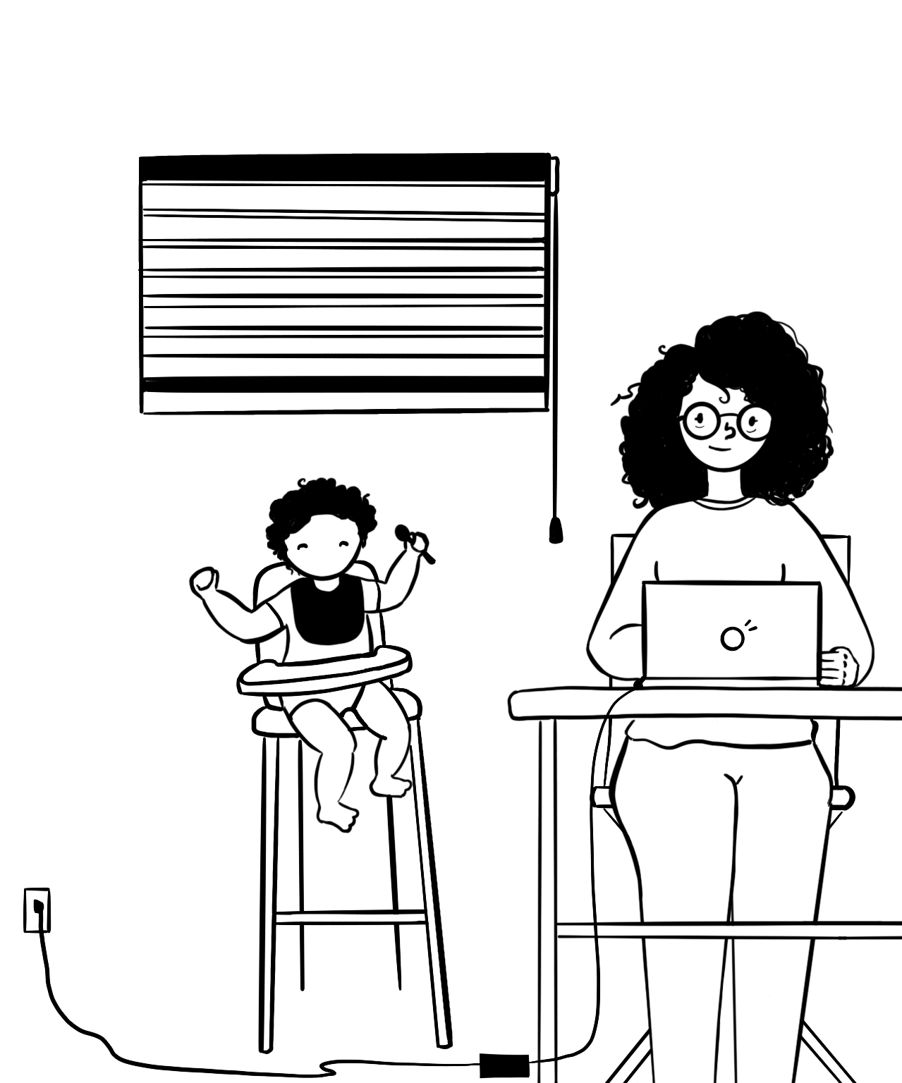
It’s good to be a parent in Québec
Québec has the best family policy in Canada, with low-cost childcare, especially compared to the rest of the country.
Québec has an affordable childcare network most parents can access. Following the implementation of its childcare network, an estimated 70,000 additional mothers were able to join the labour market.
Illustration by Diana Tzinis © 2022 RC/W

