Slide 1
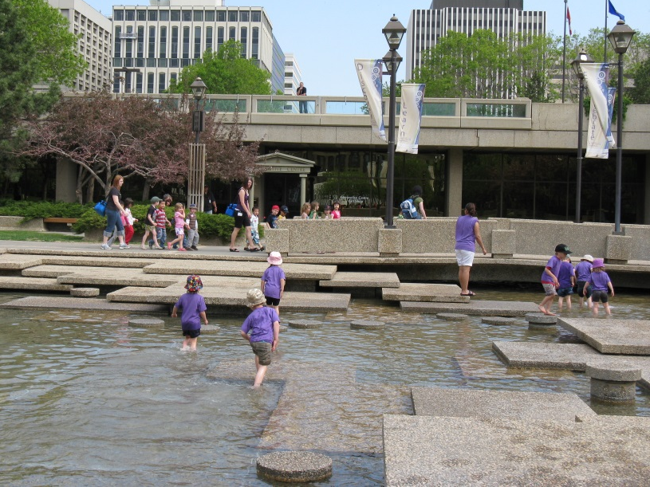
The Delivery of Non-profit Child Care: Public Good and Capacity Considerations
Who Owns Child Care? Who Should Own Child Care?
Christopher Smith, Ph.D. The Muttart Foundation

Slide 2
A New vision for ELCC in Canada: Canada-wide agreements
Federal Budget 2021 - commitment to work collaboratively with provincial and territorial governments to build a Pan-Canadian ELCC system
The transformation of ELCC sectors into ELCC systems
New federal investments of $27.2 billion over five years for provincial and territorial system building - a further $2.5 billion for Indigenous ELCC
Commitments to affordability, the expansion of services, inclusion and quality
Commitment to the creation of more high-quality, affordable regulated spaces, primarily through not-for-profit and public child care providers
Variations of this wording in individual agreements

Slide 3
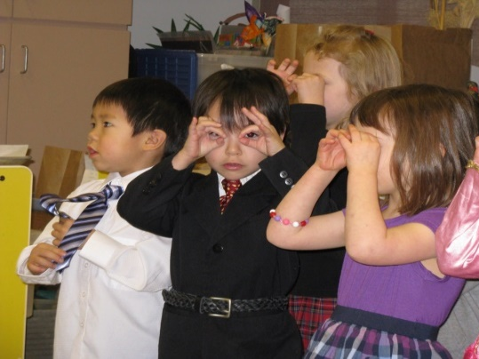
The Benefits of High-Quality Early Learning and Child Care Provision
High-quality, affordable child care can help advance a number of related public benefits
Children’s early childhood development and growth
The labour force participation of parents of young children – economic well-being
Advancing gender equity and inclusion
Support for social solidarity and the building of community
Realizing these benefits depends on how ELCC services are organized, financed and delivered – recognition of ELCC as a public good rather than a private market-based service

Slide 4
Non-Profit Early Learning and Child Care Delivery – the Role of Registered Charities
Across Canada, Canadian Charities play a vital role in the delivery of child care
Charities’ role in ELCC flows from the traditions that underpin the charitable and voluntary sector
A tradition of voluntary actions and association and a focus on public benefit
A tradition of delivering services which support government public policy goals
Charities must pursue purposes that are charitable and which advance public benefit
Governance and engagement of communities, ownership and use of resources and assets for public good
Different types of non-profit organizations – why this matters for ELCC
Community-based non-profit organizations (may be eligible for charitable registration)
Co-operatives – organized for the benefit/need of members – jointly owned enterprises
Non-profit private company – formed to promote beneficial purposes other than monetary gain

Slide 5
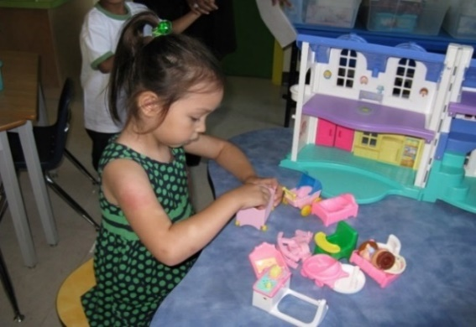
Non-Profit ELCC Services in Saskatchewan and Alberta
Saskatchewan ELCC Sector
Non-profit providers comprise the vast majority of the centre-based sector
Non-profit child care centres must have a board of directors, majority of whom are parents of children enrolled in the centre (requirement may be waived)
Limits on size of centres (up to 90 children)
For-profit centres not eligible for public funding
Alberta ELCC Sector
Non-profit providers comprise approximately 40 percent of centre-based services
Non-profit and for-profit centre-based services eligible for same public funding
Proposed Expansion of ELCC Services under Canada-Wide Agreements
Saskatchewan – expansion in non-profit centre-based services and family child care
Alberta – expansion in both non-profit and for-profit centred based services and family child care

Slide 6
Matters for Consideration in Non-profit ELCC Service Delivery in Saskatchewan and Alberta
Capacity of non-profit service providers to expand services
Access to capital
Access to infrastructure, expertise and workforce
Local mandate and focus (community-based)
Public planning and management of ELCC as a public good
Services publicly managed and planned to meet children’s and families’ needs
ELCC services responsive to community needs and actively engage stakeholders
Public funding, infrastructure and resources support the design and delivery of services that meet public policy goals

Slide 7
Non-Profit Child Care Delivery – Public Benefit and Capacity Considerations
Thank you . . . .
Your comments and questions

