Slide 1
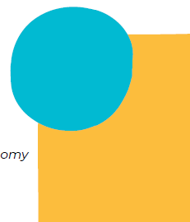
Who owns child care? Who should own child care?
Winnipeg Symposium
Non-profit child care panel discussion
April 4, 2024
Panelists
Christopher Smith
Pamela Uppal
Caryn LaFlèche
Eva Lloyd
Moderator: Jane Beach

Slide 2
The lay of the land: Non-profit child care in Canada
At a Canada-wide level, 71% of centre-based child care spaces are operated on a non-profit basis (in 2021)
There is significant variation in the proportion of non-profit child care across provinces and territories
For-profit child care has been steadily growing, from 20% of Canada-wide supply in 2004 to 29% in 2021
A lower percentage of full-day spaces are non-profit than part-day spaces in a majority of provinces and territories
Across Canada 48% of full-day centre spaces are non-profit compared to 78% of part-day spaces
Source: Early Childhood Education and Care in Canada 2021

Slide 3
The context: Non-profit child care in Canada
Under the Canada-wide Early Learning and Child Care Agreements, expansion is to occur primarily in the non-profit and public sectors
The focus of expansion is on full day child care for children 0-5
Provinces and territories have a range of approaches to planning for and funding expansion, including some that are funding and supporting for-profit growth
There are numerous types of non-profit child care operations
Stand-alone centres, often operated by individual parent boards
Multi-site organizations
Multi service organizations
Charitable vs non-profit legal status with different accountability requirements
The “grey” areas – social enterprises, co-ops, participation of some for-profit entities in non-profit provision

Slide 4
Questions to consider
Are some forms of non-profit child care more viable or preferable than others?
Does the non-profit sector have the capacity to meet PT expansion targets? What supports do they need?
How do non-profits fit into the planning process?
Who initiates their establishment?
What happens when there is no non-profit to develop and operate new child care facilities?
How do non-profits access capital funding and who should own a publicly funded facility?
Where should non-profit provision fit into the mix of a universal system?

