Slide 1
Public child care – Overview and context
Presenters
Martha Friendly (Moderator)
Rianne Mahon
Merete Villsen
Julie Cyr
Bonny Traverse
Definition
…owned and operated by a public (“state”) government entity such as a municipality, school board or Indigenous governing body.

Slide 2
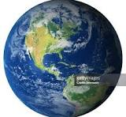
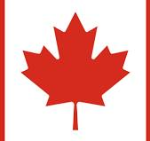
How does publicly owned child care fit in?
Beyond our borders…
In countries with mature child care systems, public child care predominates (although there is some non-profit and for-profit provision).
There is no well-developed ELCC system that doesn’t have a significant public sector.
In Canada…
Historically - very little public child care. Not the norm or default.
This is shared by the liberal democratic welfare regimes (all of which uses market child care models).

Slide 3
What does/can/could it look like?
Municipalities (or municipal entities)
School authorities
Indigenous governing bodies
Local health bodies
New entities (e.g. Regional Children’s Councils – Manitoba Commission report 2016)
Two roles, both important:
- public ownership
- public management
This symposium is about the first, but the second will undoubtedly arise, esp regarding municipalities.

Slide 4
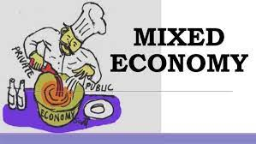
What assets can public child care bring to implementation of CWELCC ?
- Spaces! Critical need for
not-for-profit expansion
- “Steering”- where and what
- Public ownership - facilities/land
- Economies of scale
- Stability of public services
- Local - subsidiarity
*
IN REALITY….

