Slide 1

THE NONPROFIT DIFFERENCE IN CHILD CARE: UNPACKING THE GOOD, THE BAD, AND THE UGLY
PAMELA UPPAL, DIRECTOR OF POLICY
APRIL 4, 2024

Slide 2

Working together towards a
STRONG AND RESILIENT NONPROFIT SECTOR

Slide 3
THE VISION ONN IS SUPPORTING
  A Canada-wide licensed child care system that is accessible, affordable, and high quality.
  Nonprofit and public sector driven system.
  Decent work for child care workforce.
  “Tax credits and deductions are policy tools favoured by many governments, but they do not build child-care spaces or reliable care systems.”

Slide 4
MULTI-FACETED PUBLIC POLICY
  Decent Work Systems: 77% of workers in Ontario’s nonprofit sector are women, many of whom rely on child care to work outside of the home.
  Anti-privatization of publicly funded services: 70% of child care in Ontario is delivered by nonprofits, but it is actively being opened up to for-profit providers.
  Social Purpose Real Estate: Child care requires real estate, a hot commodity, that can be protected through nonprofits. Nonprofits are well positioned to meet physical infrastructure needs that communities require, keep these spaces in community hands, and retain them for the future as the needs of their surrounding communities evolve.
  A network approach to advocacy: Complimenting the work of existing provincial groups such as Ontario Coalition for Better Child Care and Association of Early Childhood Educators to bring together child care networks across anglophone, francophone, Indigenous-led, home-care, centre based care, co-op child care, and special resource teachers.

Slide 5
THE NONPROFIT DIFFERENCE IN PUBLICLY-FUNDED SERVICES
  Government, for-profit, and nonprofit actors each have distinct characteristics that make them uniquely suited to deliver different kinds of services for community.
  The purpose, governance, and ownership structure of nonprofits (“the nonprofit difference”) makes nonprofits uniquely positioned to deliver publicly-funded services, particularly care services.

Slide 6
THE NONPROFIT DIFFERENCE
 | Nonprofits | For profits
Purpose | Nonprofits exist to meet a need for a public good/benefit. Decisions must be made prioritizing this community need. As a result, a systems approach can be taken that finds, and fills the gaps in our province. | Businesses exist to make profit, while this can incentivize initial capital investments, higher quality or quantity of services, it can also incentivize lower quality or quantity services where doing so is more profitable. It is rarely profitable to serve the most complex needs.
Governance | Nonprofits are accountable to community members and a volunteer board of directors. This helps ensure accountability and responsiveness to those served locally, and beyond. | Businesses are accountable to shareholders who are unlikely to have any ties to the community or needs.
Ownership | Revenues are reinvested in services, and assets must remain in the hands of a registered charity if the nonprofit dissolves by giving to other nonprofits or government (“asset lock”). | The maximum amount of revenue possible goes to shareholders, and key infrastructure may be sold at any time if it is profitable to do so. Profits may flow out of the province/country.

Slide 7
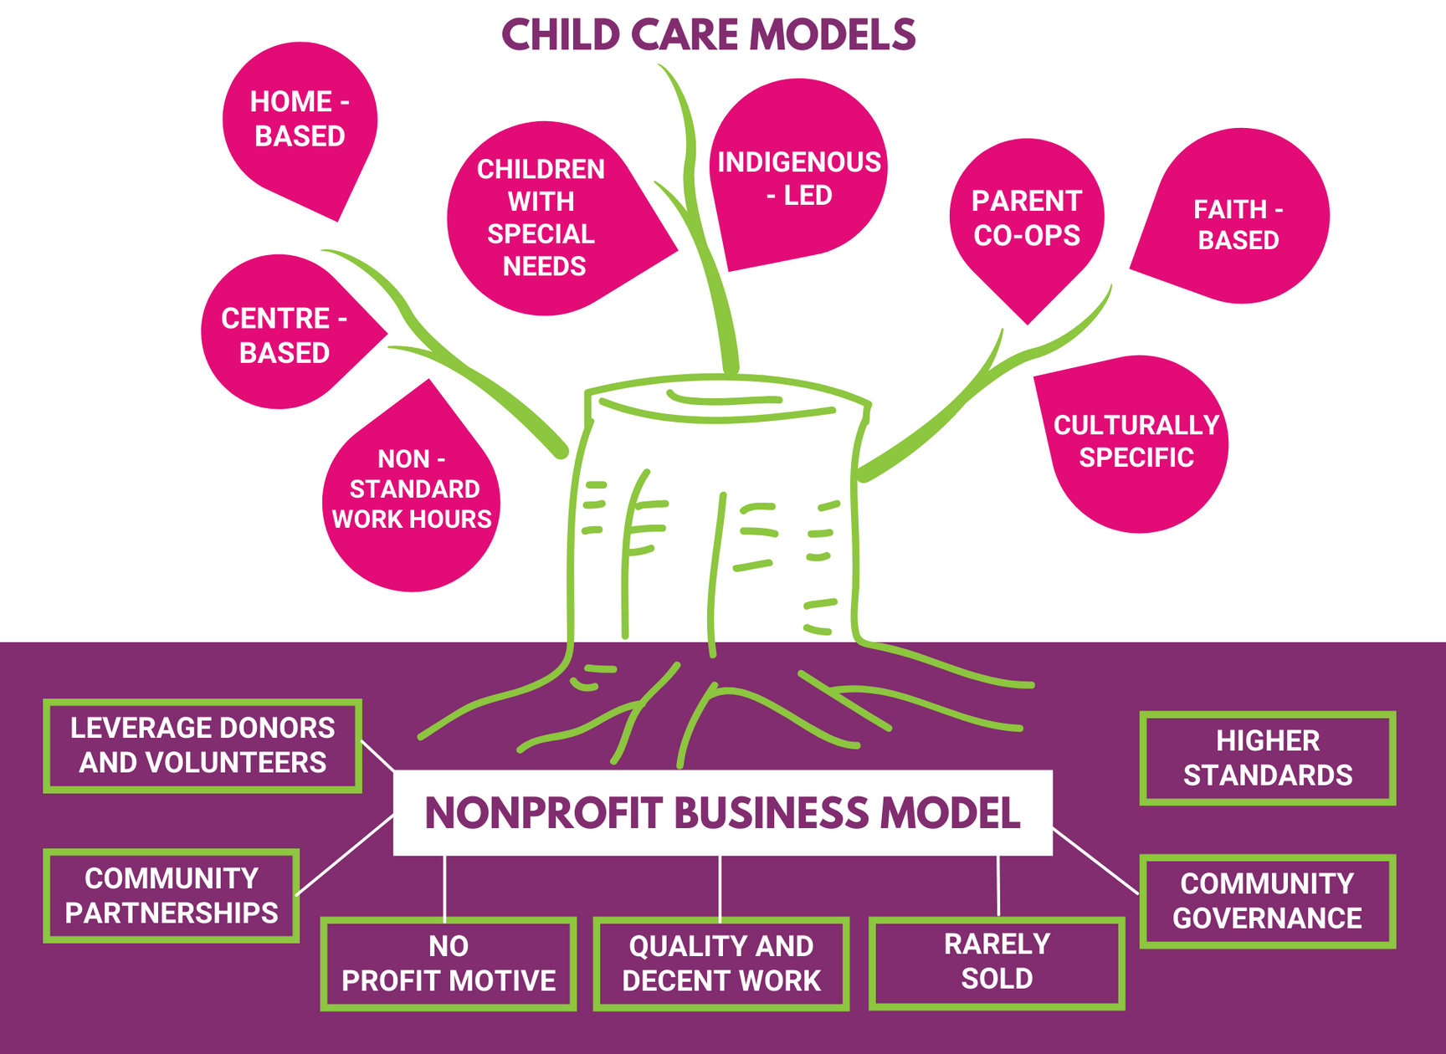

Slide 8
THE ONTARIO CONTEXT:
PUBLIC POLICY ISSUES
  Workforce shortages: Inability to recruit and retain the workforce needed to deliver quality care at current levels, let alone meet expansion goals.
  Outdated funding formula: Does not reflect the true cost of delivering services and caters to for-profits.
  Expansion is not possible without capital: Need sufficient and transparent stackable capital that consists of grants and below-market repayable loans at variety of junctures for expansion.
  No universal child care without equitable access: Various provincial associations and networks are stewarding equity plans - Assemblée de la francophonie de l'Ontario (AFO), Ontario Federation of Indigenous Friendship Centres, and Early Childhood Resource Teacher Network of Ontario.

Slide 9
THE ONTARIO CONTEXT:
ADVOCACY ISSUES
  Government relations: Strong provincial bureaucratic relationships that are not necessarily resulting in any supportive action for nonprofit providers.
  Media: Difficultly getting sustained media attention on the complexity and nuances of the child care issue in a chaotic media environment and with a strong for-profit lobby.
  Public: Lack of understanding and awareness on what the “nonprofit difference” is.
  Community members: Difficulty reaching and organizing parents, especially those seeking care.

Slide 10
THE VISION WILL NOT HAPPEN ORGANICALLY
  The vision is a tall order!
  Nonprofits want to expand but that will not happen organically and without significant capital investment and key partnerships (in Ontario’s case the municipalities are key).
  Nonprofits cannot compete with for profits - for profits are organized, have ready capital, the ear of governments, and a strong voice in the public realm.
  There are some silver linings:
    New funding formula in Ontario is pending
    Promising capital funding from the federal government
    Talks of a social acquisition fund for child care

Slide 11
NONPROFIT DRIVEN CHILD CARE RESOURCES
  Discussion paper on the Ontario government’s proposed funding formula (2023)
  Nonprofits deliver high-quality, felxible child care choices (2022)
  Nonprofits deliver a canada-wild child care system (2021)
  Protecting community assets through nonprofits (2018)

Slide 12





Thank you for joining!
o_n_n
Ontario_Nonprofit
_Network
Ontario Nonprofit
Network
info@theonn.ca
theonn.ca

