Slide 1
The Quebec model and for-profit child care WHO OWNS CHILD CARE? WHO SHOULD OWN CHILD CARE? Winnipeg, April 3-4 2024
Sophie Mathieu, PhD
Vanier Institute of the Family

Slide 2
Roadmap
The Quebec model in 2024: more children in for-profit child care than in the non-profit CPEs
Quebec’s initiatives (Grand chantier pour les familles) to complete its child care network
The Quebec model from a historical perspective
Affordability
Accessibility
Quality

Slide 3
The Quebec model in brief
Child care is heavily subsidized in Quebec
Three avenues to subsidize child care in Quebec:
Subsidized and non-profit (centres de la petite enfance)
Subsidized and for-profit (services are provided at the same costs as in non-profit centres)
Unsubsidized and for-profit (parents get a portion of their fees reimbursed)

Slide 4
Quebec’s child care network in brief
Quebec’s child care network was created as part of the 1997 family policy.
Originally, the plan was to offer all spaces within non-profit childcare centres, the “centres de la petite enfance” (CPE) for $5 per day.
implementation of a five- year moratorium of the creation of child care spaces in for-profit centres (garderies).
In 2003, a new Liberal government, in conjuncture with the end of the moratorium and pressure to develop new spaces led the government to open the door wide to for-profit garderies.

Slide 5
Access to for-profit garderies has been facilitated since 2003
2003: end of 5 year moratorium
Enhanced tax refunds for parents using non-subsidized child care services
2008/2009: families with income up to $80,000 paid the same amount for child care services, irrespective of service type
This equality was extended to families earning up to $125,000 in 2010.

Slide 6
The Quebec model in 2024: most child care spaces are subsidized
In 2022, 65.6% of preschool children were enrolled in regulated child care
300,924 child care spaces are available (as of January 2024).
78.6% of those child care spaces are offered at $9.10 per day in 2024.
Source: Tableau de bord –Données au 30 janvier 2024. Développement du reseau des services de garde éducatifs à l’enfance. Ministère de la famille.

Slide 7
The Quebec model in 2024: “subsidized” does not mean “non-profit”
Spaces provided by the CPEs in child care facilities have been decreasing since 2003
In addition, child care spaces are offered in family environments (garderies en milieu familial). These spaces are subsidized most of the time.
 | CPE | Subsidized and for-profit | Non-subsidized and for-profit
1998 | 60.9% | 38.5% | 0.5%
2003 | 69.9% | 28.2% | 1.9%
2008 | 62.2% | 30.0% | 5.7%
2013 | 49.0% | 24.6% | 26.4%
2018 | 45.0% | 22.1% | 32.9%
2023 | 46.2% | 26.0% | 27.7%

Slide 8
The Quebec model in 2024: more children in the garderies than in the CPEs
Source: Ministère de la famille. 2024. Tableau de bord –Données au 30 novembre 2023. Développement du reseau des services de garde éducatifs à l’enfance.

Slide 9
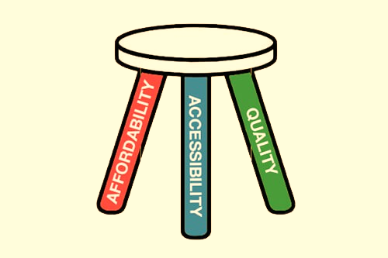
Issues with for-profit child care
Affordability
Less an issue in Quebec than in the other provinces
In 2024: $9.10/day in CPEs and subsidized childcare
With budget 2024-2025, the commitment to offer subsidized spaces to a greater number of families was reaffirmed
Accessibility
Often easier access, especially for those that offer unsubsidized spaces
Currently, there are 30, 660 children on a waiting list and in need of a space before October 2023; an additional 34,000 children need a childcare space after October 31 2023.
Quality
The for-profit centres offer lower quality than the CPEs.
Since 2019, 89% of CPE, 64% of subsidized garderies and 53% of unsubsidized garderies have reached the minimum thresholds on four quality indicators (quality of interactions, quality of physical environment, quality of activity planning, quality of interactions with parents).

Slide 10
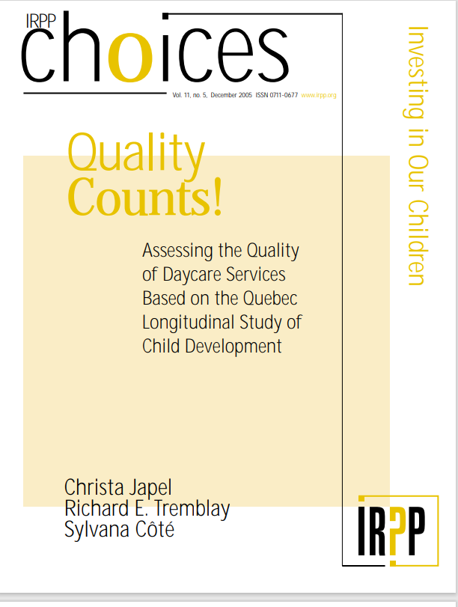
Quebec is not doing well when it comes to quality
Before the pandemic, the Educational Childcare Regulation stated that 2 out of 3 child care educators needed to be qualified in child care facilities
In 2018…
92% of CPEs
81% of subsidized child care centres
and only 33% of unsubdizied child care centres
complied with the qualification requirement for educational staff
Source: Ministère de la famille. 2020. Accessibilité aux services de garde éducatifs à l’enfance. Audit de performance et observations du commissaire du développement durable. Rapport du vérificateur général du Québec à l’Assemblée nationale pour l’année 2020-2021.

Slide 11
Qualified staff ratio and pandemic
Educational Childcare Regulation and ratio of trained child care educators
Period | Ratio
Before the pandemic | 2 out of 3 child care educators
March 24, 2021 to March 1, ,2023 | 1 in three child care educators
March 2, 2023 to March 1, 2024 | 1 out of 2 child care educators
From March 2, 2024 | 2 out of 3 child care educators

Slide 12
More unqualified child care educators
Departures and hirings of educational staff in CPEs and child care centres, April 1, 2021 to March 31, 2022
 | Qualified | Unqualified | Total
Departure | 3,046 (51.7%) | 2,848 (48.3%) | 5,894
Hiring | 2,990 (42.5%) | 4,050 (57.5%) | 7,040
Source: Ministère de la famille. 2023. Portrait de la main-d’œuvre du réseau des services de garde éducatifs à l’enfance 2021-2022. Gouvernement du Québec.

Slide 13
Quebec’s plan to complete its network: more for-profit garderies
The Grand chantier pour les familles (“Major initiatives for families”) is Quebec’s action plan to complete its provincial child care network.
With this plan, the Minister of Families is committed to create more subsidized child care spaces before the end of 2025.
Budget 2024
CPEs not mentioned once in 434 pages
government committed to ‘’gradually converting non-subsidized spaces in the network into subsidized spaces’’

Slide 14
Quebec’s action plan to complete its childcare network
Increase the number of children per facility, from 80 to 100
Streamline the opening process for CPEs
Allow temporary facilities to accommodate children
Allowing the integration of non-legally recognized and unlicensed childcare services into the formal service network

Slide 15
Who owns child care in Quebec? Who is likely to own child care in the future?
For-profit child care centres have taken an increasing share of spaces since 2003; there is no indication of a change in direction.
Is Quebec still the model to follow? In 2024, most child care spaces are offered outside the non-profit CPEs; waiting lists continue to be an issue and trained child care educators are increasingly being replaced by untrained educators.

Slide 16
Thank you/merci
Sophie Mathieu, PhD
Senior Program Specialist
The Vanier Institute of the Family
smathieu@institutvanier.ca
sophiemathieu.ca

