Slide 1
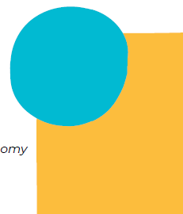
Who owns child care? Who should own child care?
Winnipeg Symposium
For-profit childcare panel discussion
Gordon Cleveland
Sophie Mathieu
Aisling Gallagher
Moderator: Susan Prentice

Slide 2
Overview
For-profit landscape in Canada
Quebec’s experience
Private equity firms & financialization (NZ)
How to establish guard rails around the for-profit sector?
How to preserve value and assets paid for by public spending?
How to protect & promote quality in highly commercialized jurisdictions?

